Slide 1
Create an Account on Azure
Create a free account

Slide 2
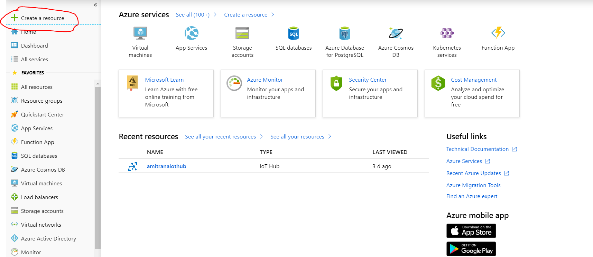
Create an IoT Hub

Slide 3
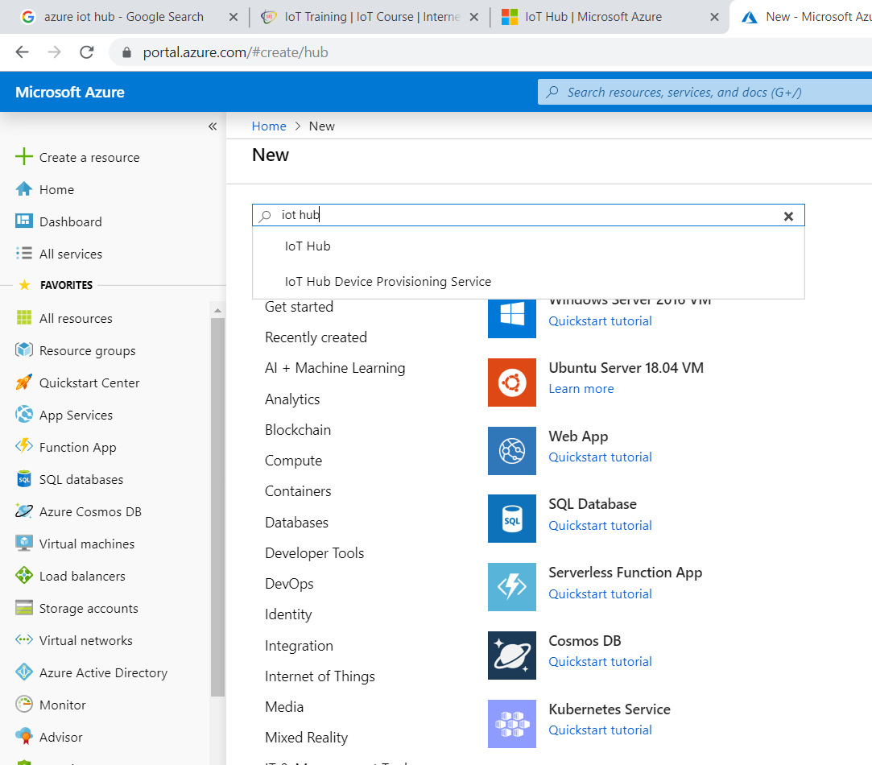

Slide 5
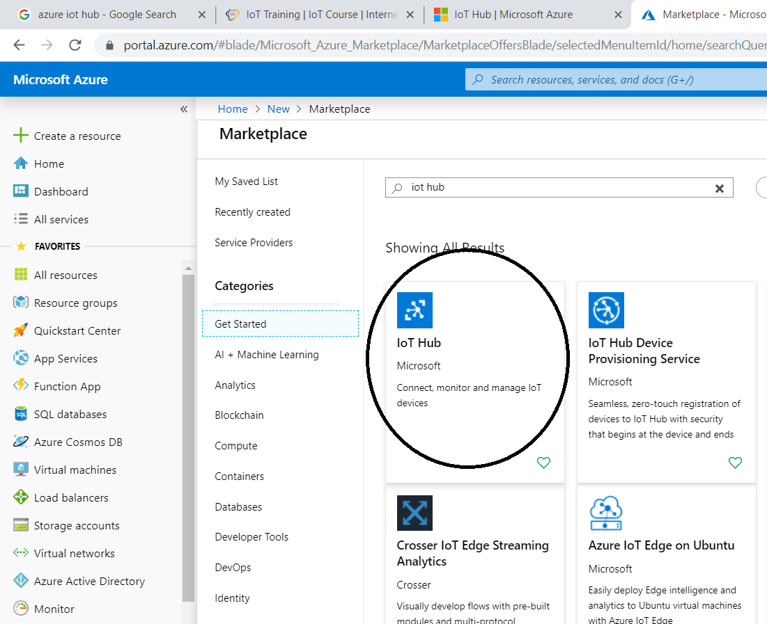

Slide 6
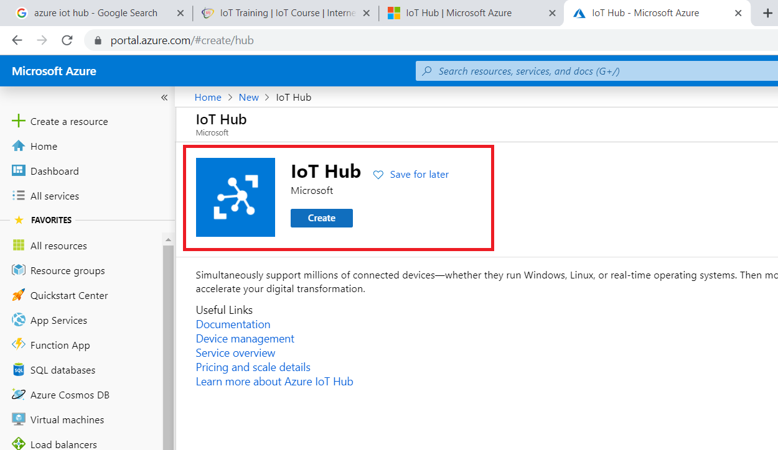

Slide 7
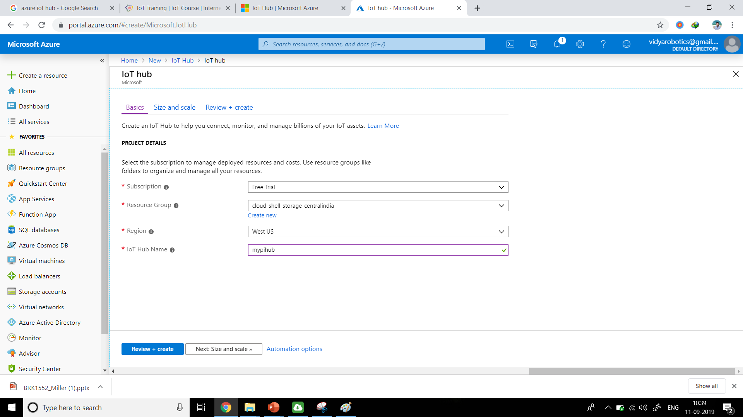

Slide 8
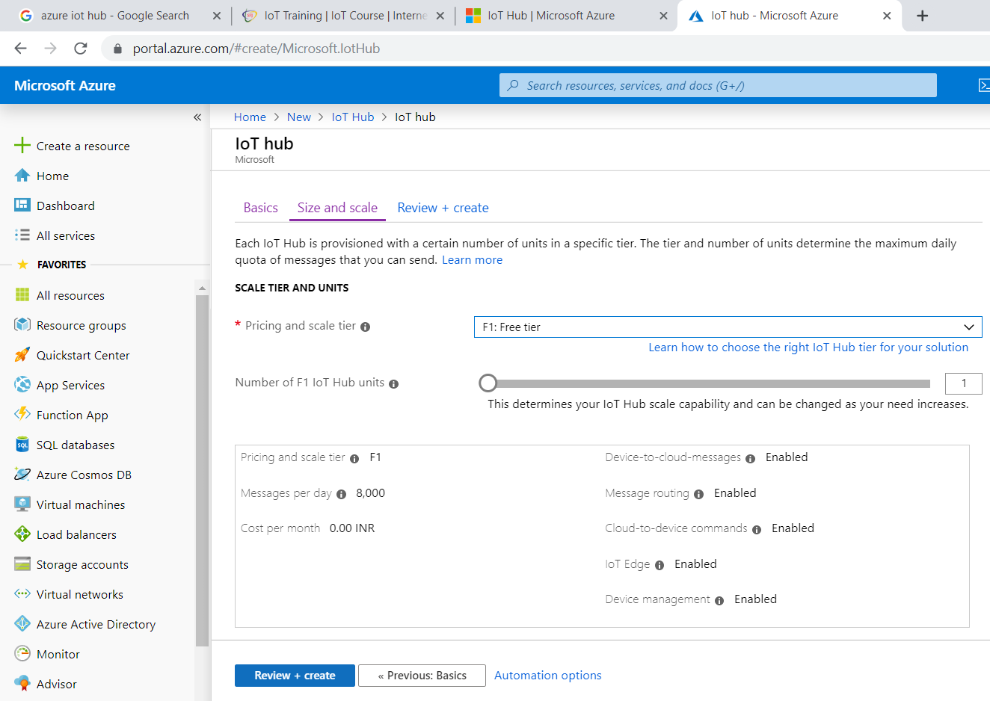

Slide 9
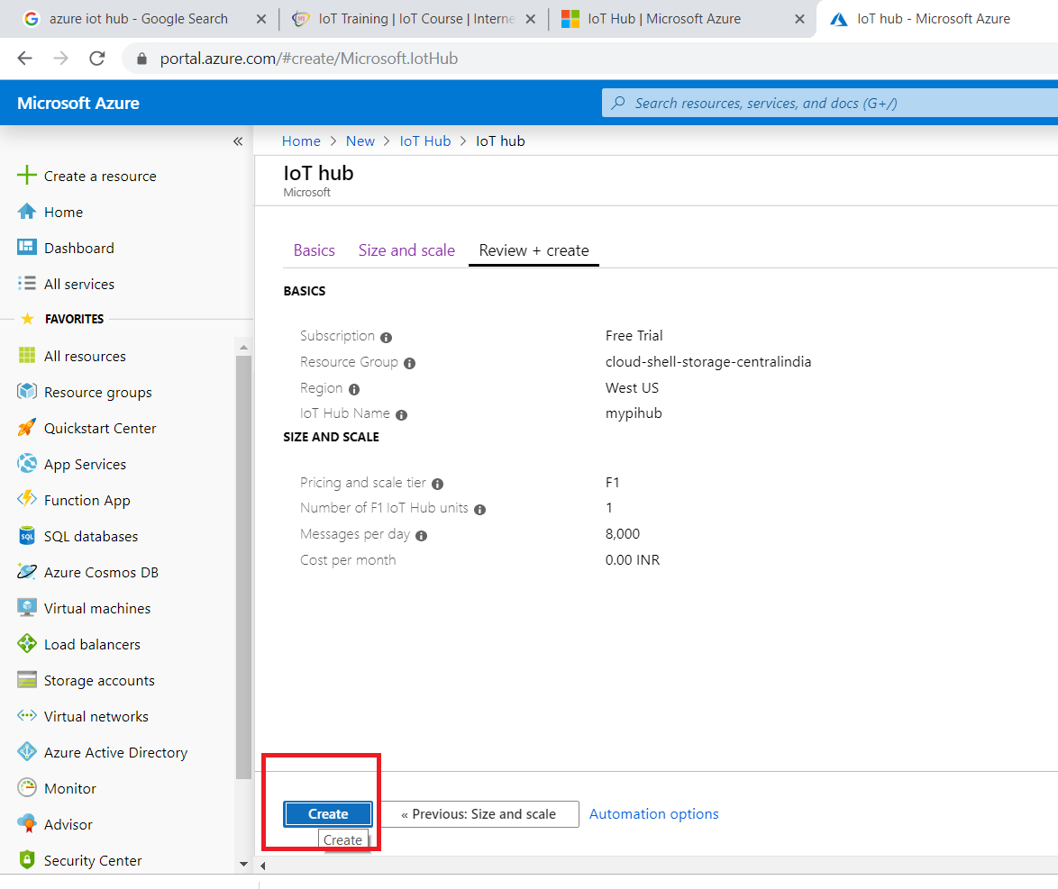

Slide 10
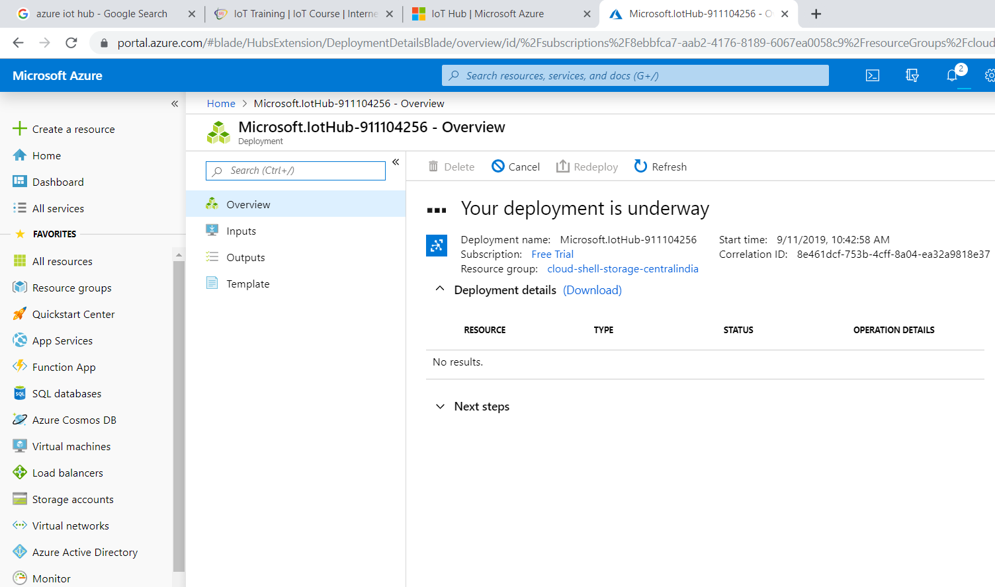

Slide 11
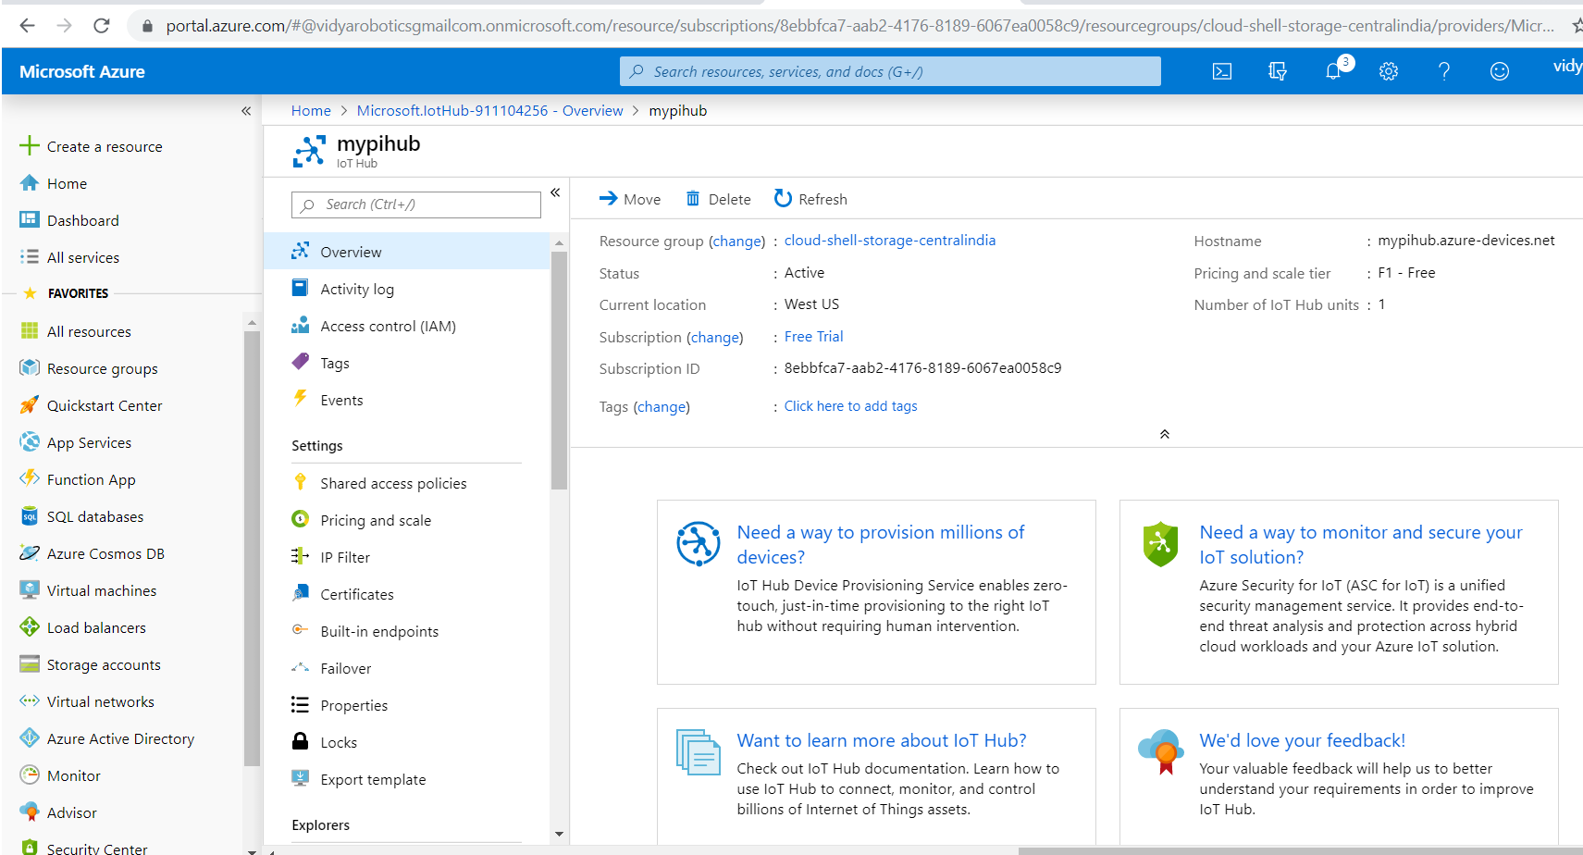

Slide 12
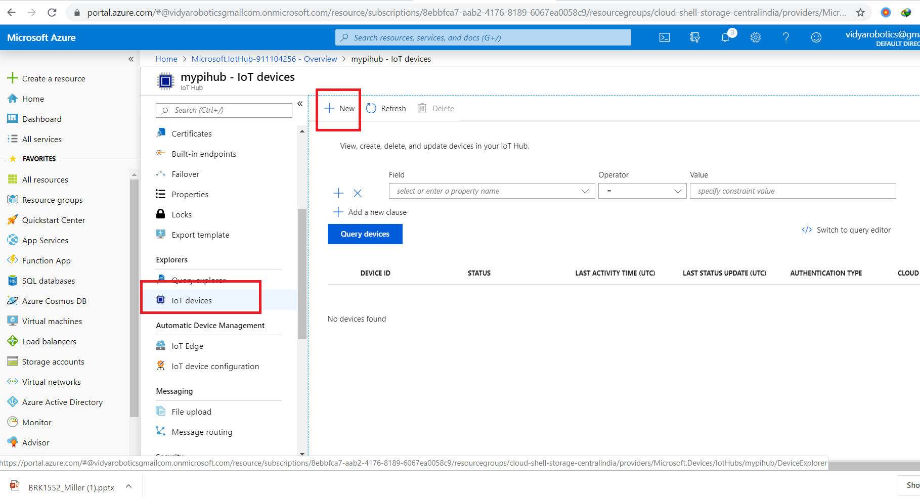

Slide 13
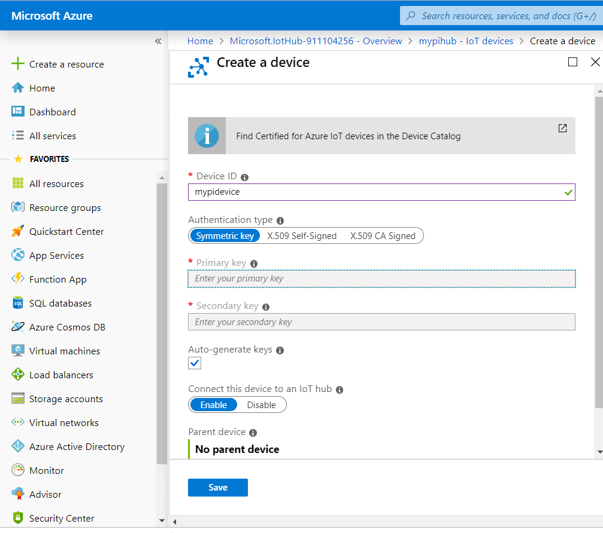

Slide 14
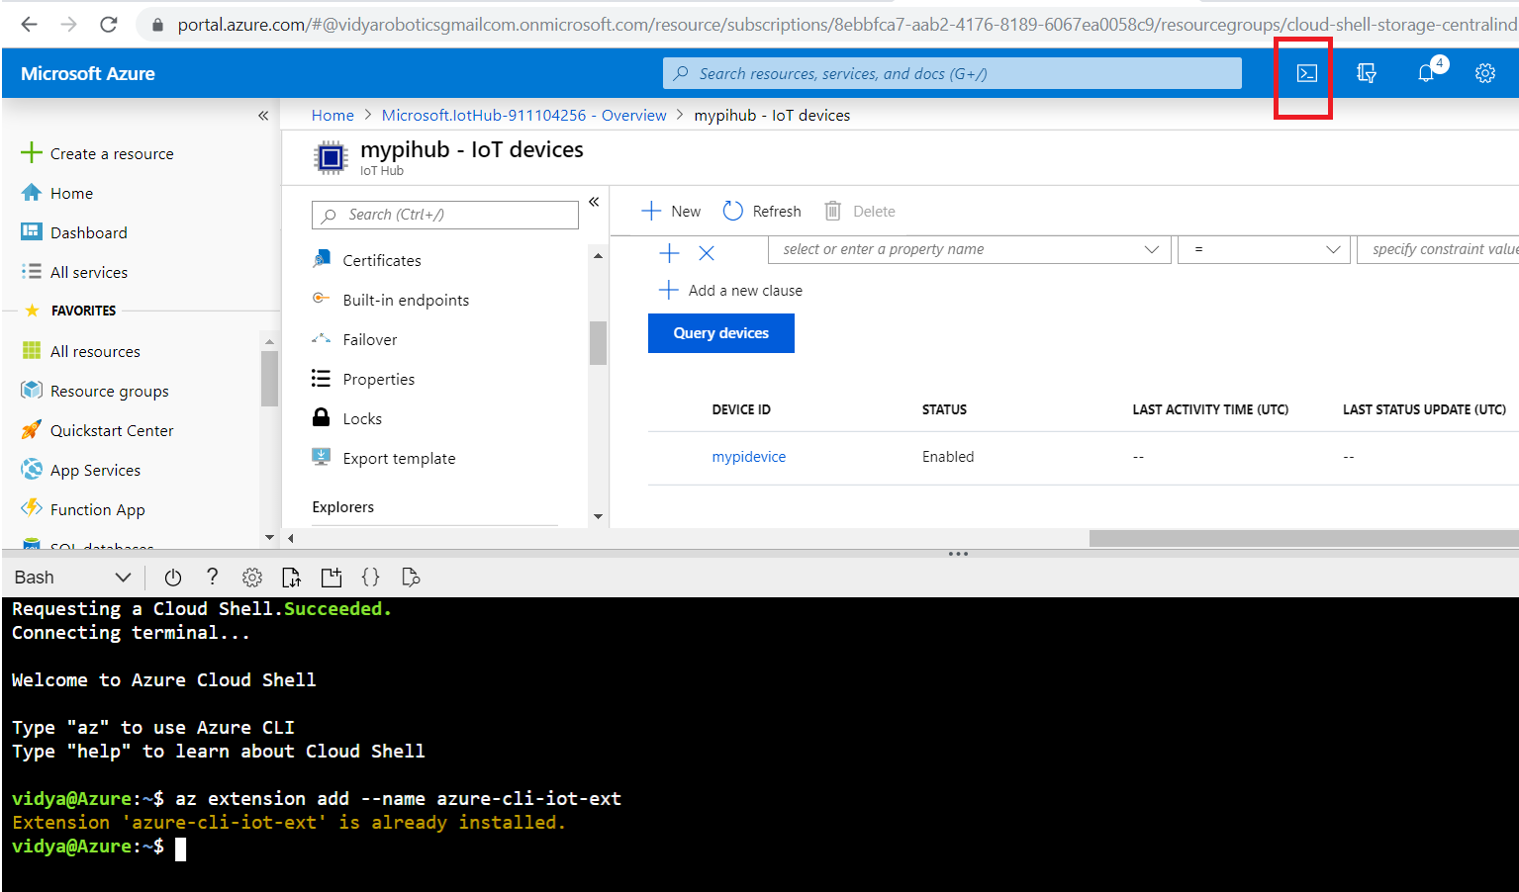

Slide 15
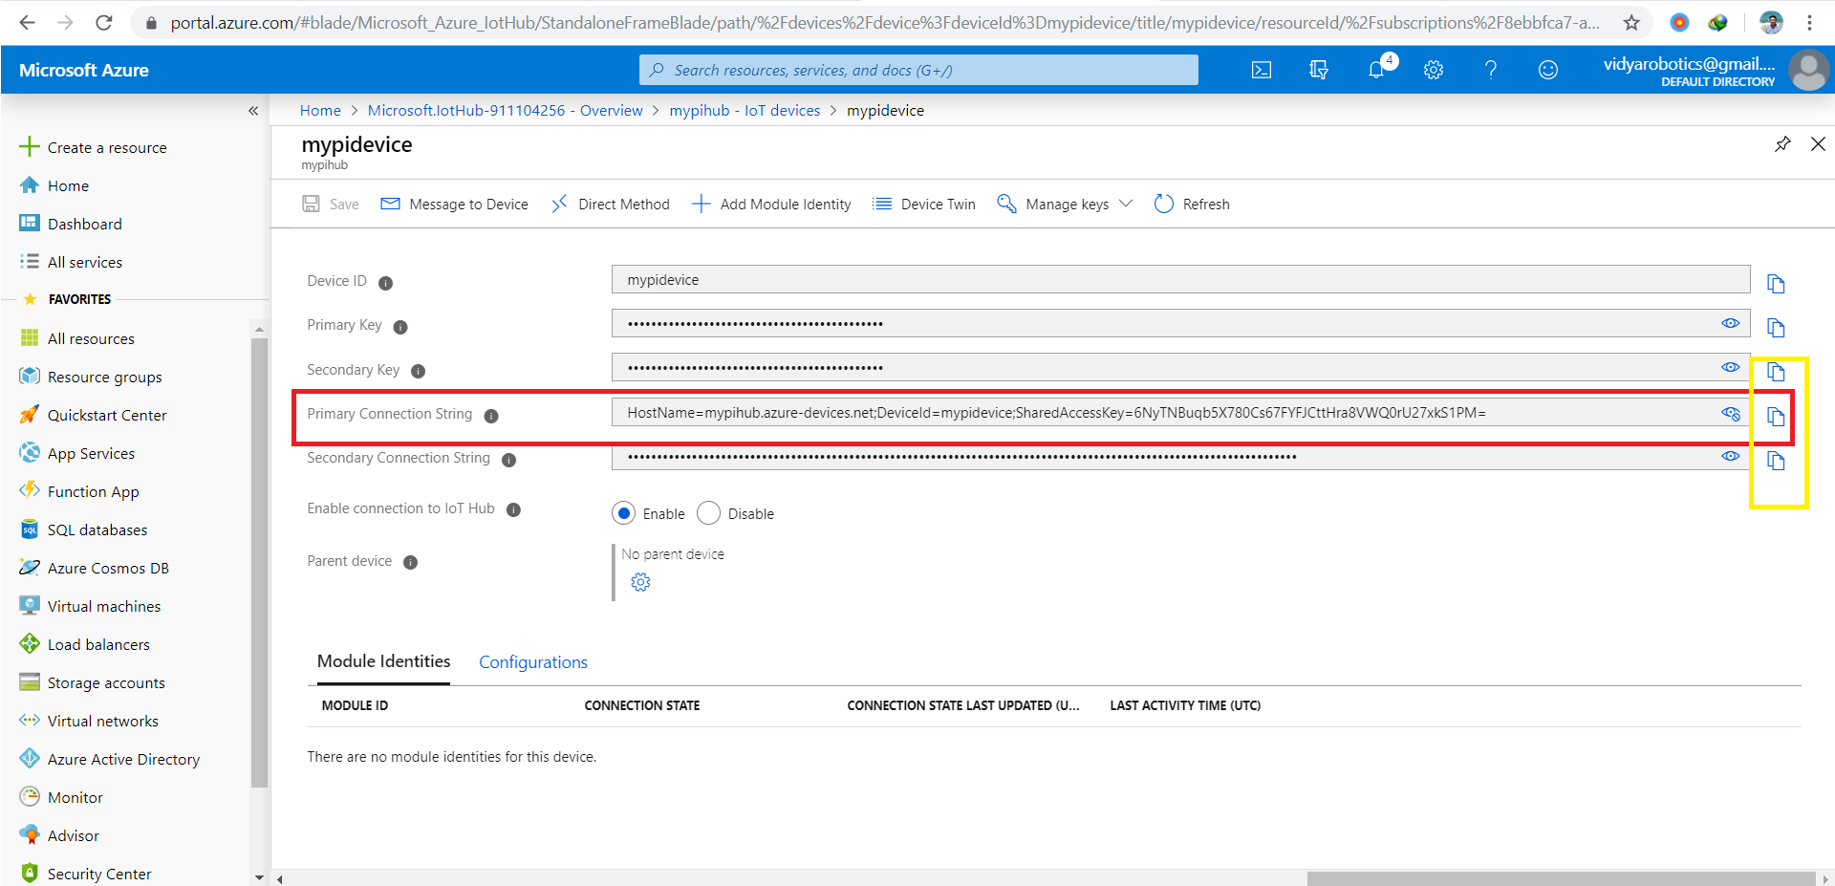

Slide 16
az extension add --name azure-cli-iot-ext
az iot hub monitor-events --hub-name kitflix --device-id mypi

Slide 17
Install Package
sudo pip3 install azure-iot-device
sudo pip3 install azure-iot-hub
sudo pip3 install azure-iothub-service-client
sudo pip3 install azure-iothub-device-client

Slide 18
Install Software's on Raspberry pi
Open python Code
Change the connection string
Run this in azure shell
az extension add --name azure-cli-iot-ext

Slide 19
Complete Command prompt Instructions
az iot hub device-identity create --hub-name YourIoTHubName --device-id MyPythonDevice
az iot hub device-identity show-connection-string --hub-name YourIoTHubName --device-id MyPythonDevice --output table
Now note down the connection string shown.
Run
SimulatedDevice.py
az iot hub monitor-events --hub-name YourIoTHubName --device-id MyPythonDevice

Slide 20
Read Telemetry on Cloud for iot hub
az extension add --name azure-cli-iot-ext
az iot hub monitor-events --hub-name YourIoTHubName --device-id MyPythonDevice
az iot hub monitor-events --hub-name mypihub --device-id mypi

Slide 21
Microsoft Azure Stream Analytics

Slide 22
Stream Analytics
Stream Analytics is a fully managed, PaaS service
It help you analyze and process fast moving streams of data from IoT devices,

Slide 23
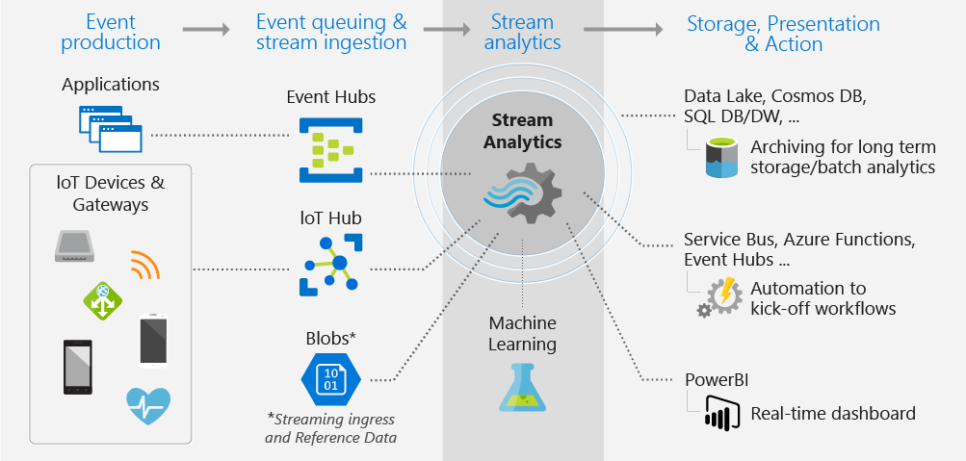
Stream Analytics

Slide 24




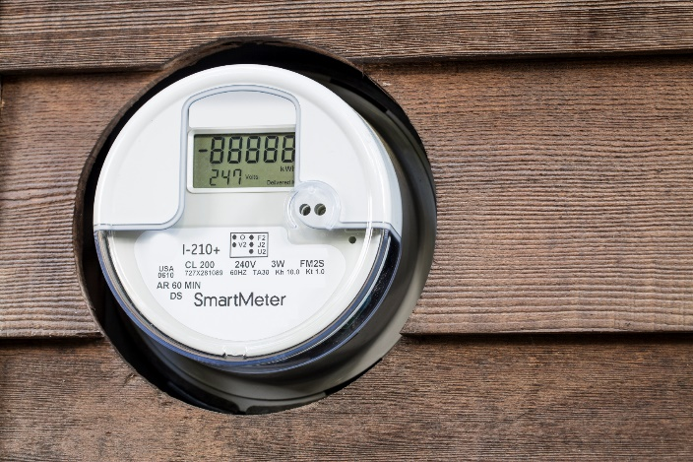



What are customers wanting to do?
Real-time financial sales tracking
Connected car scenario
Click-stream analysis
Real-time financial portfolio alerts
Smart grid
CRM alerting sales with customer scenario
Data and identity protection services
Real-time fraud detection

Slide 25
How do developers create a real-time streaming solution?
Monitoring and Troubleshooting of solution
Develop solutions and infrastructure for increasing scale with business growth
Develop solutions to manage resiliency, such as infrastructure failures
Develop solutions to integrate with other components like ML, BI etc
Develop solution (code) for ingress, processing and egress
Infrastructure – Procure and setup
Development and operations resources
Time

Slide 26
Developers using Azure Stream Analytics
Monitoring and Troubleshooting of solution
Develop solutions and infrastructure for increasing scale with business growth
From Event or Data Streams to Real Time Insights in less time with less people resources
Develop solutions to manage resiliency, such as infrastructure failures
Develop solutions to integrate with other components like ML, BI etc
Develop solution (code) for ingress, processing and egress
Infrastructure – Procure and setup

Slide 27


what
High Throughput
Dashboard
Monitoring
Internet of Things
Command & Control
Real Time
Blob Archiving
Low Latency

Slide 28

Canonical Event-driven Scenario
Event producers
Collection
Ingestor (broker)
Transformation
Long-term storage
Presentation and action
Stream Analytics
Web/thick client dashboards
Applications
Service bus
Event hubs
Azure DBs
Legacy IOT (custom protocols)
Stream processing
Search and query
Cloud gateways (web APIs)
Azure storage
Devices
Storage adapters
HDInsight
Data analytics (Excel)
IP-capable devices (Windows/Linux)
Low-power devices (RTOS)
Field gateways
Devices to take action

Slide 29



Introducing stream analytics
Fully managed real-time analytics
Mission critical reliability and scale
Enables rapid development

Slide 30
Real-time analytics
Intake millions of events per second
Process data from connected devices/apps
Integrated with highly-scalable publish-subscriber ingestor
Easy processing on continuous streams of data
Transform, augment, correlate, temporal operations
Detect patterns and anomalies in streaming data
Correlate streaming with reference data

Slide 31
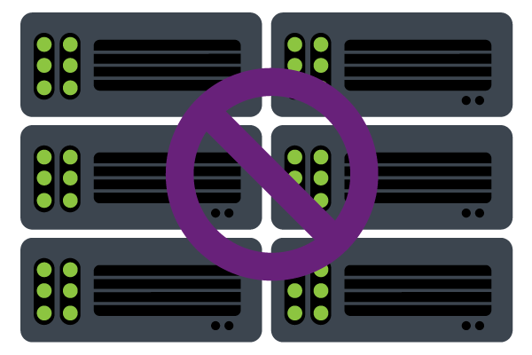
No hardware acquisition and maintenance
Bypasses deployment expertise
Up and running in a few clicks (and within minutes)
No software provisioning and maintaining
Easily expand your business globally
No challenges with deployment

Slide 32
Introducing stream analytics
Fully managed real-time analytics
Mission critical reliability and scale
Enables rapid development

Slide 33
Mission critical reliability
Guaranteed events delivery
Guaranteed not to lose events or incorrect output
Preserves event order on per-device basis
Guaranteed business continuity
Guaranteed uptime (three nines of availability)
Auto-recovery from failures
Built in state management for fast recovery

Slide 34
No challenges with scale
Elasticity of the cloud for scale up or scale down
Spin up any number of resources on demand
Scale from small to large when required
Distributed, scale-out architecture
Scale using slider in Azure Portal and not writing code
Low startup costs
Provision and run Streaming solution for as low as $25/month
Pay only for the resources you use
Ability to incrementally add resources
Reduce costs when business needs changes

Slide 35
Introducing stream analytics
Fully managed real-time analytics
Mission critical reliability and scale
Enables rapid development

Slide 36
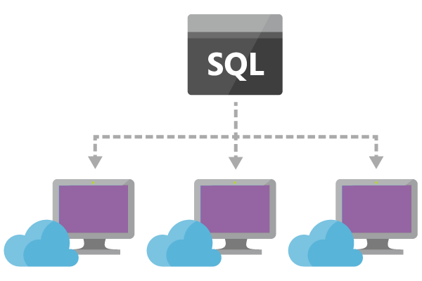
Rapid Development
Decrease bar to create Stream Processing Solutions via SQL-like Language
Easily filter, project, aggregate, join streams, add static data with streaming data, detect patterns or lack of patterns with a few lines of SQL
Built-in temporal semantics
Development and debugging experience through Azure Portal
Manage out-of-order events & actions on late arriving events via configurations
Rapid Development

Slide 37
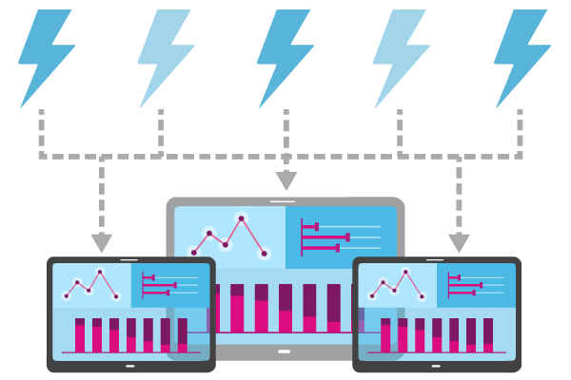
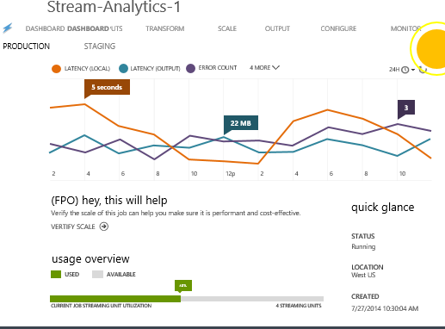
Scheduling and monitoring built in
Built-in monitoring
View your system’s performance at a glance
Help you find the cost-optimal way of deployment

Slide 38

End-to-End Architecture Overview
Azure Stream Analytics
Outputs
SQL Azure
Azure Blobs
Event Hub
Temporal Semantics
Guaranteed delivery
Guaranteed up time
Transform
Temporal joins
Filter
Aggregates
Projections
Windows
Etc.
Enrich
Correlate

Event Inputs
Event Hub
Azure Blob
BI Dashboards
Predictive Analytics

Reference Data
Azure Blob
☁
Azure
Storage
Data Source
Collect
Process
Deliver
Consume

Slide 39
Stream Analytics: Hands on

Slide 40
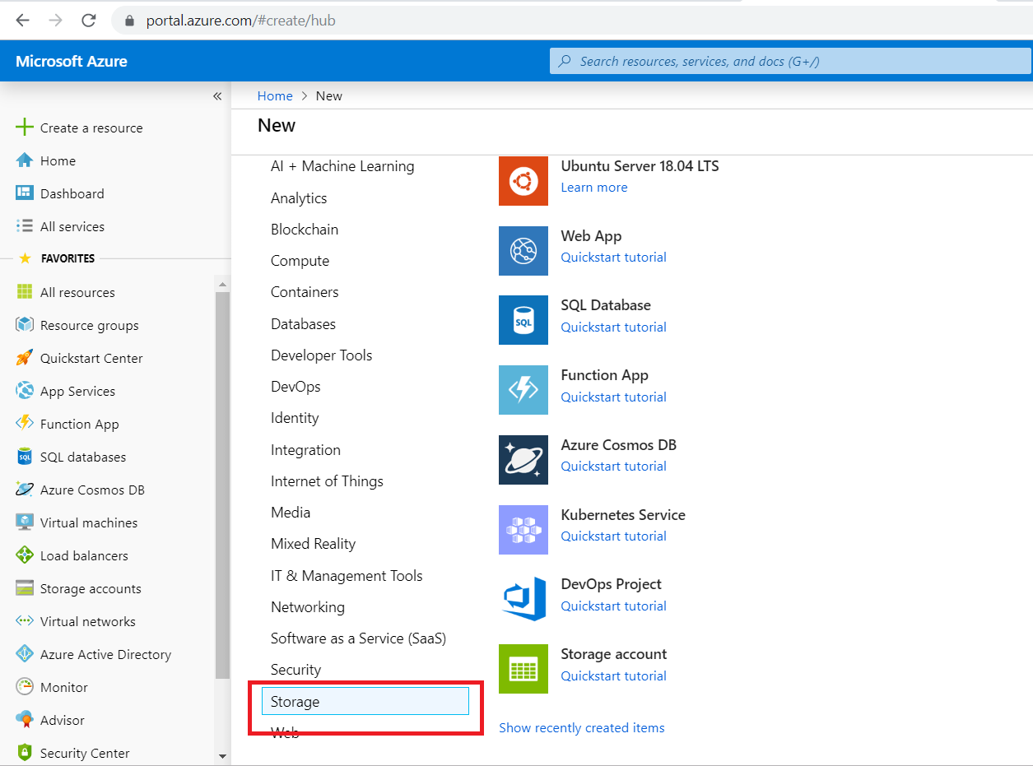

Slide 41
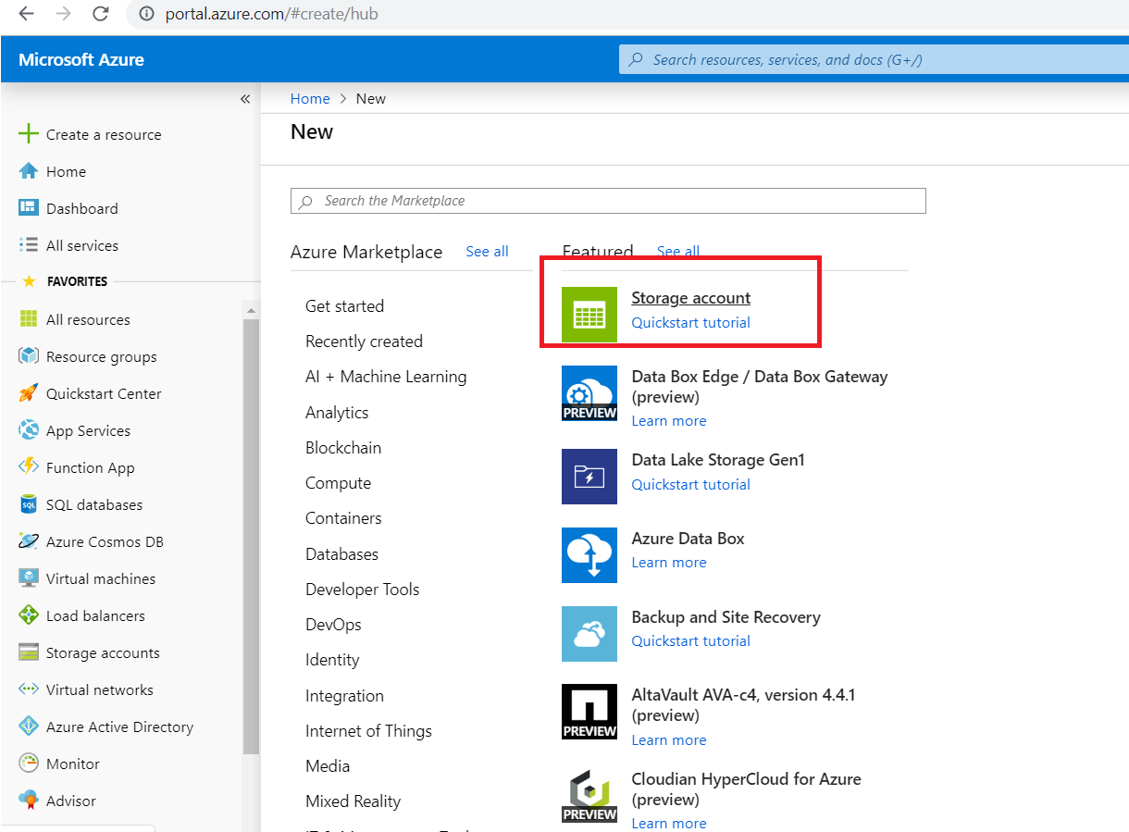

Slide 42
Create storage
enter a storage account name, location, and resource group. Choose the same location and resource group as the IoT Hub you created

Slide 43
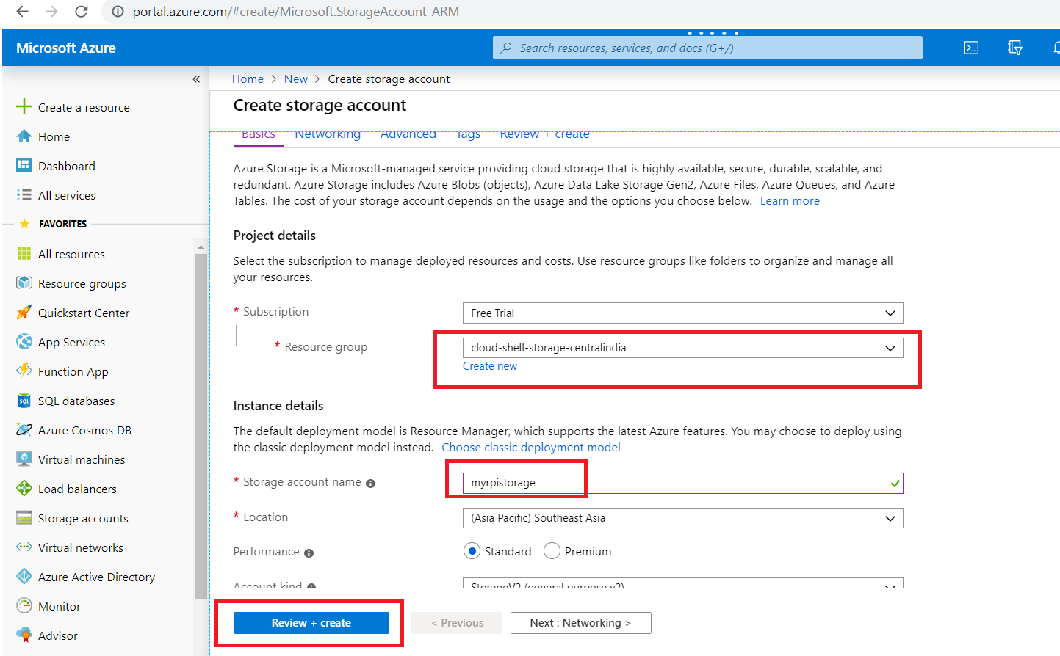

Slide 44
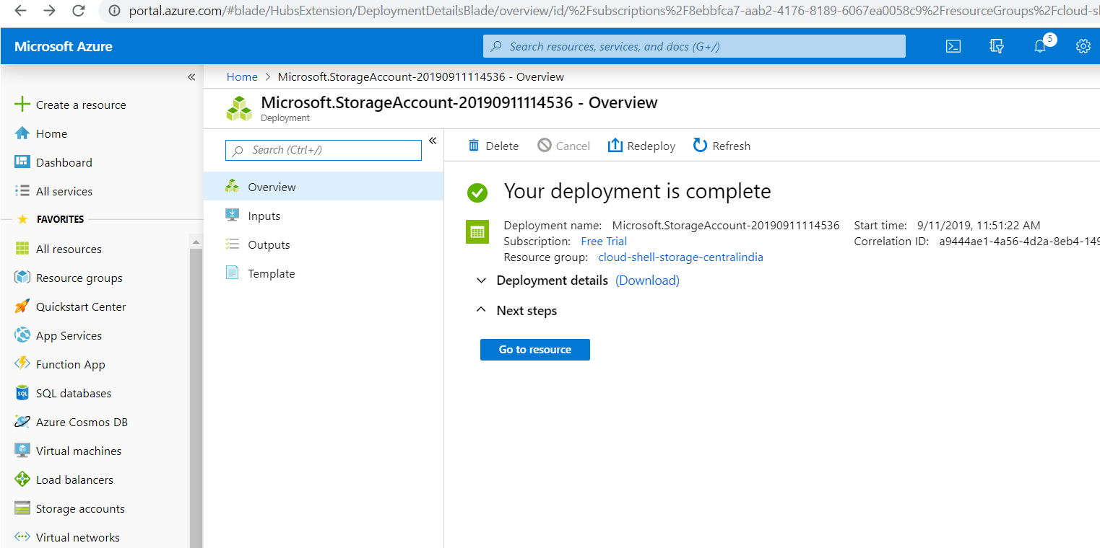

Slide 45
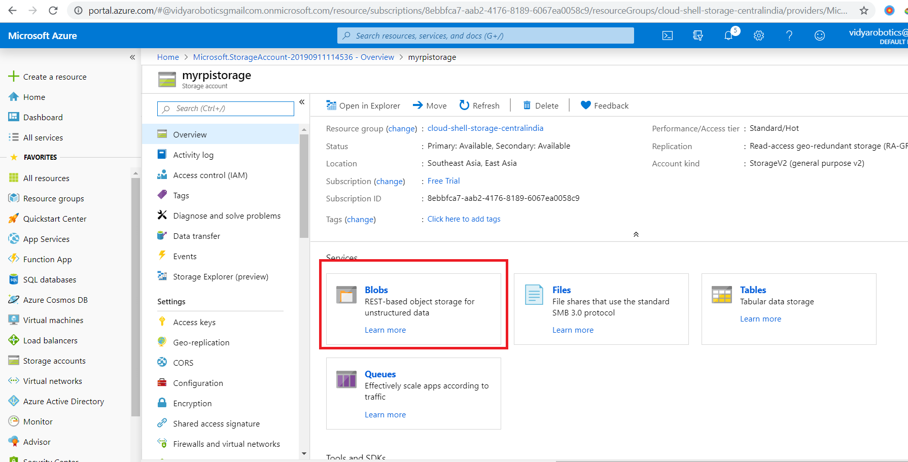

Slide 46
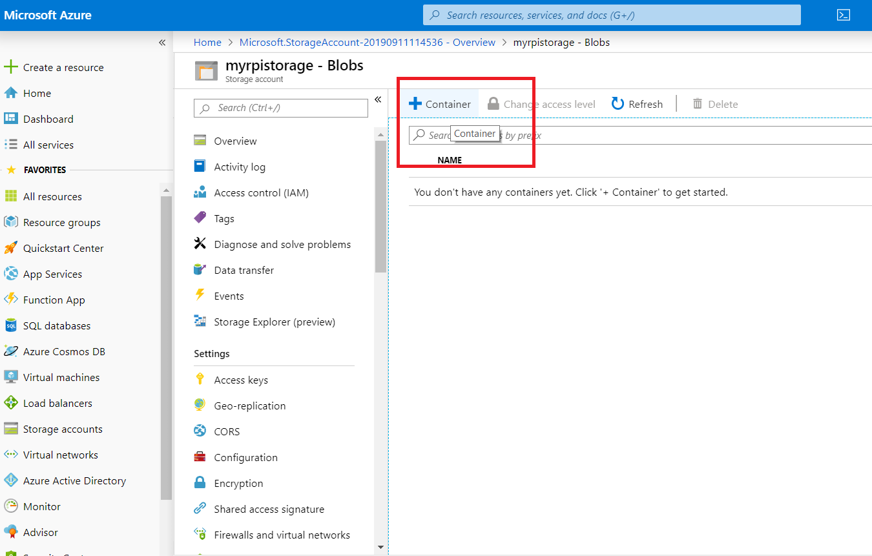

Slide 47
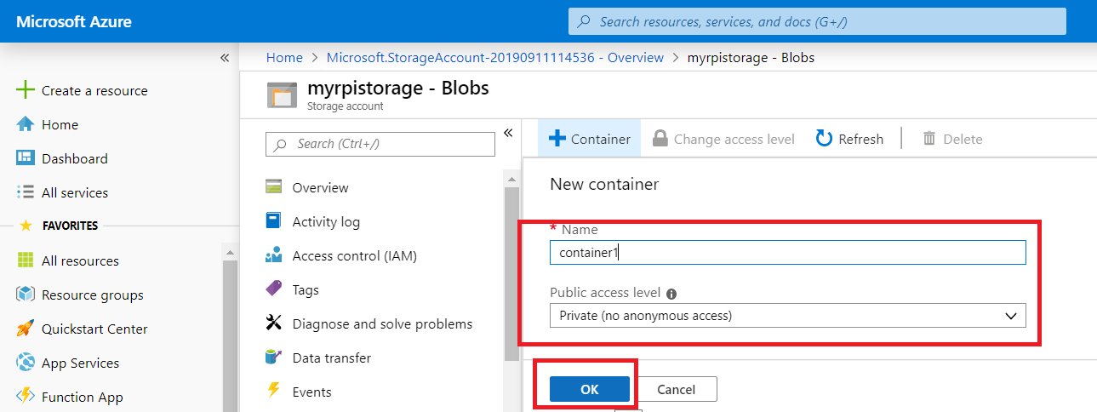

Slide 48
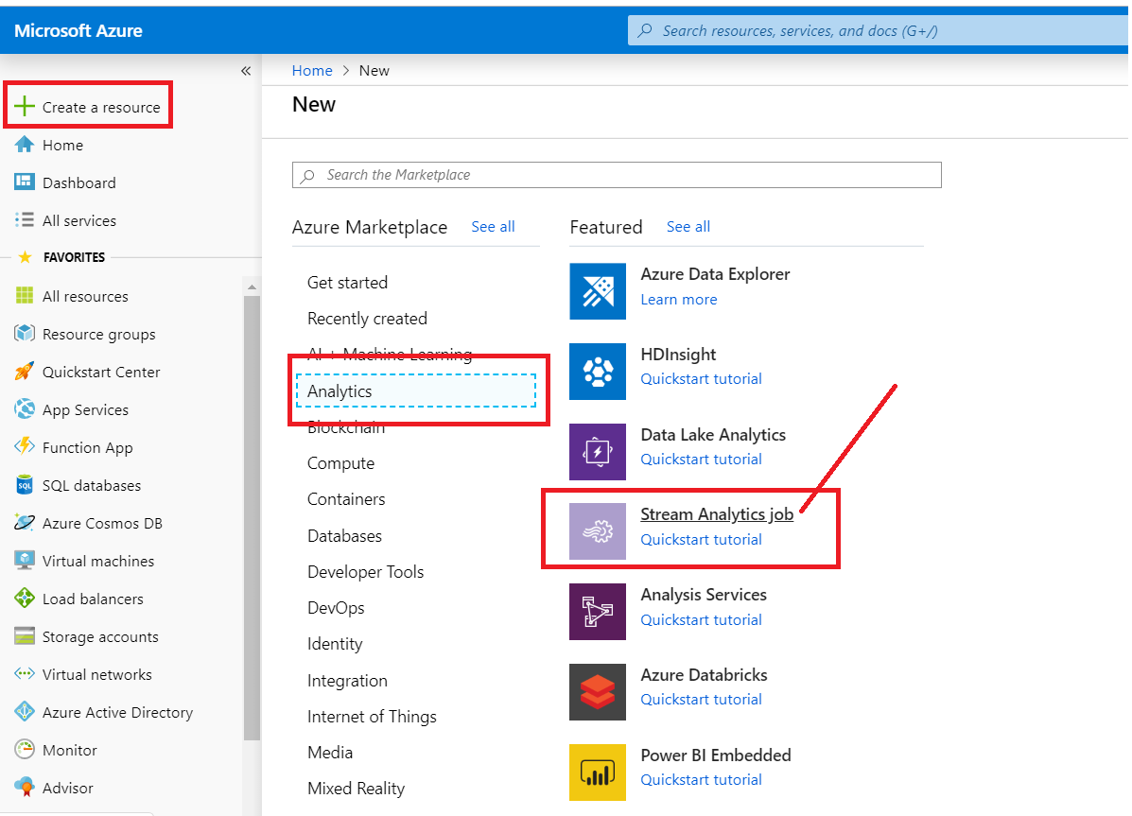

Slide 49
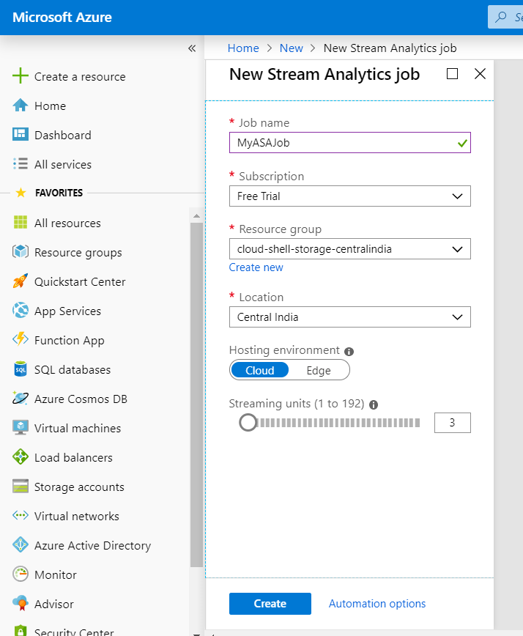

Slide 50
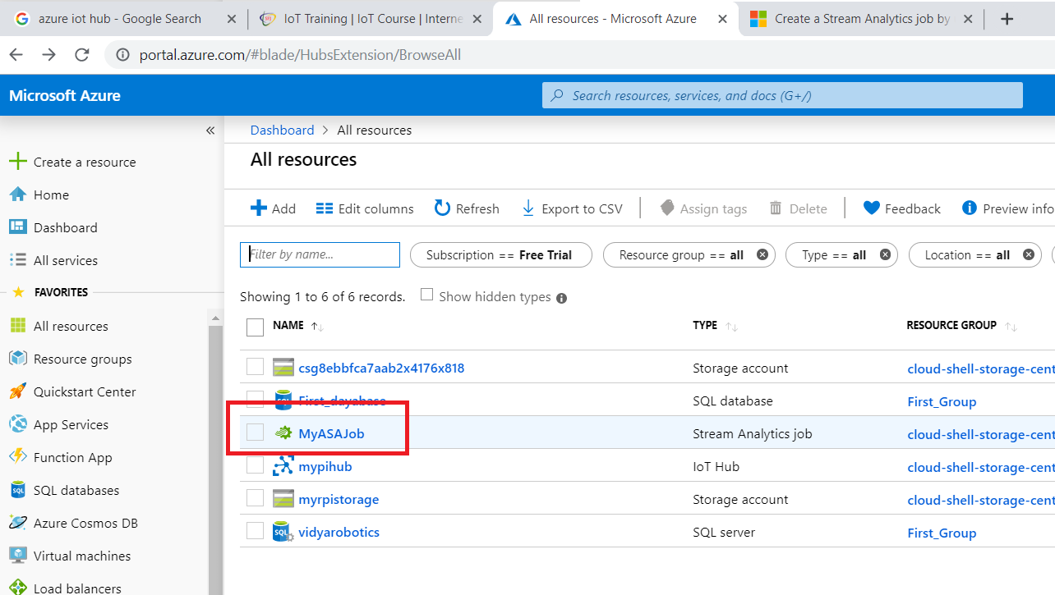

Slide 51
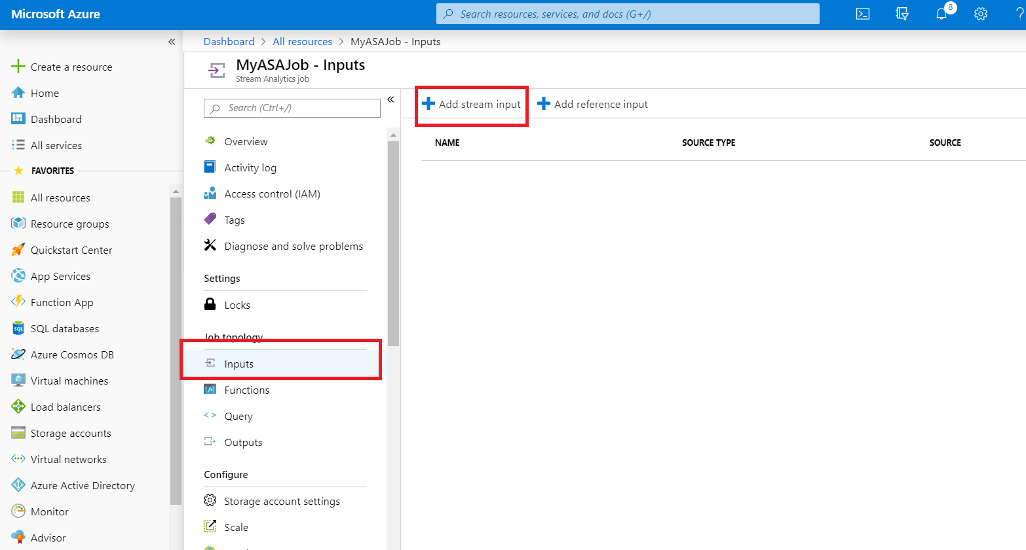

Slide 52
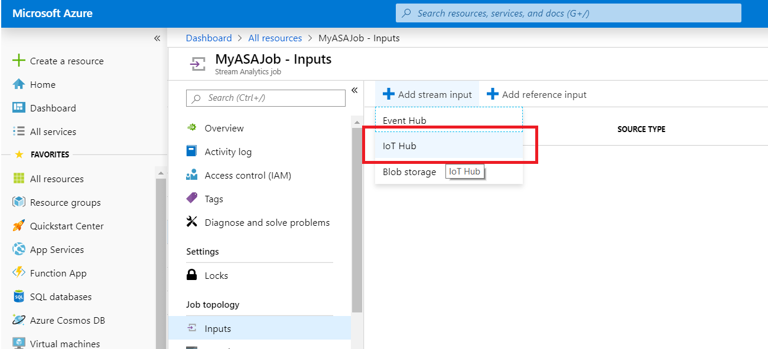

Slide 53
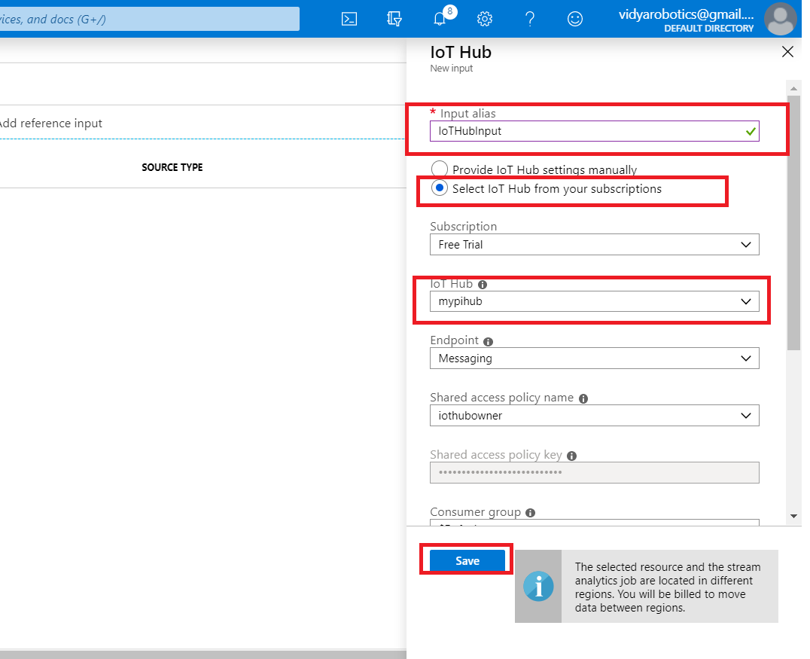

Slide 54
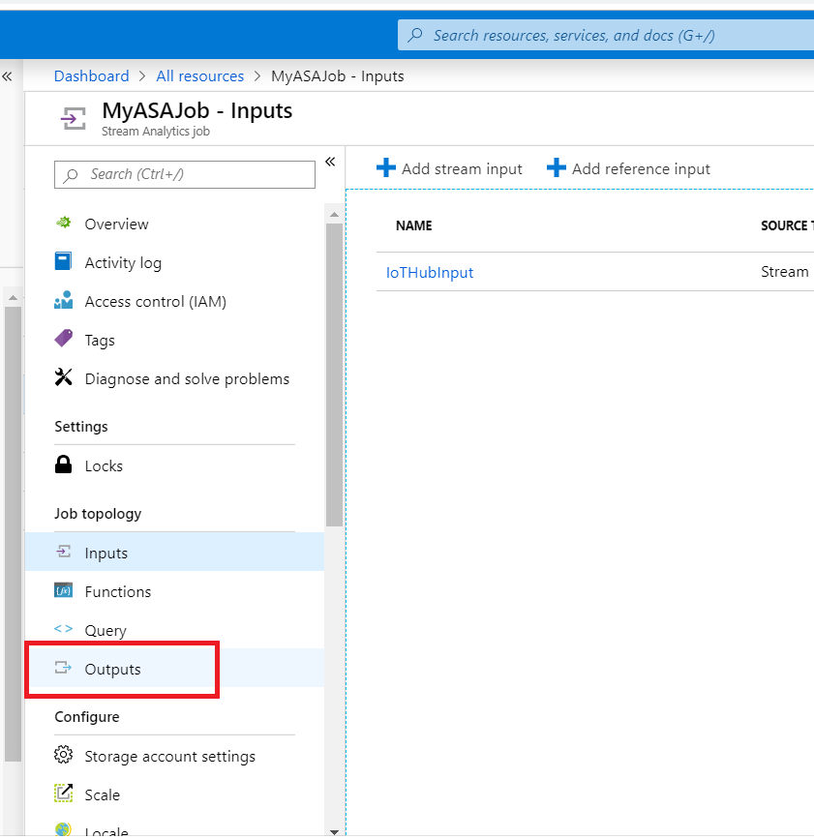

Slide 55
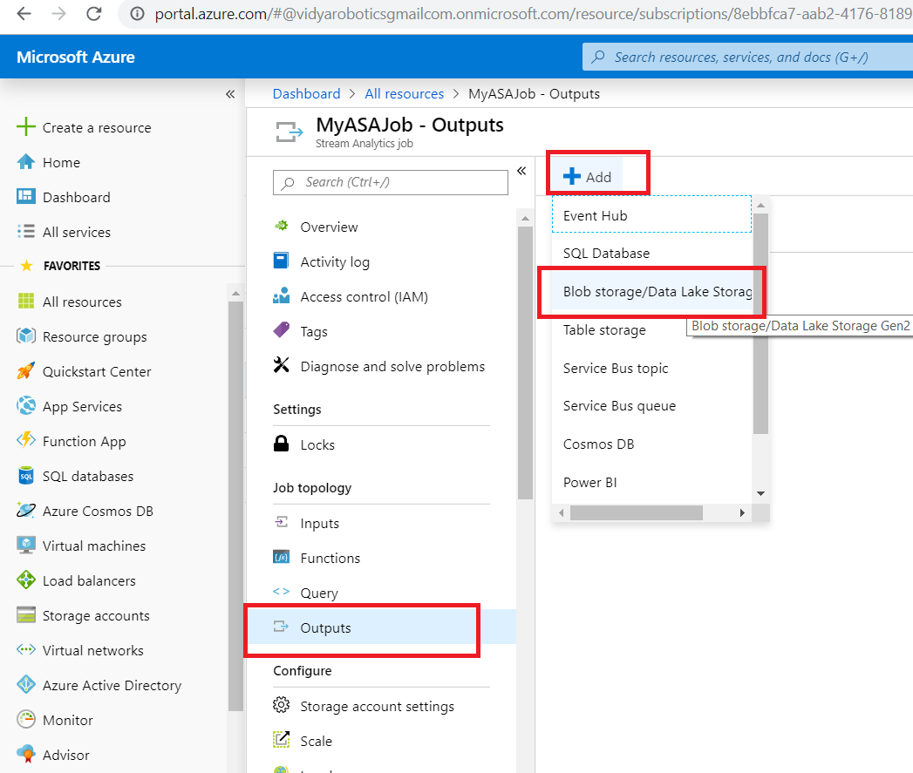

Slide 56
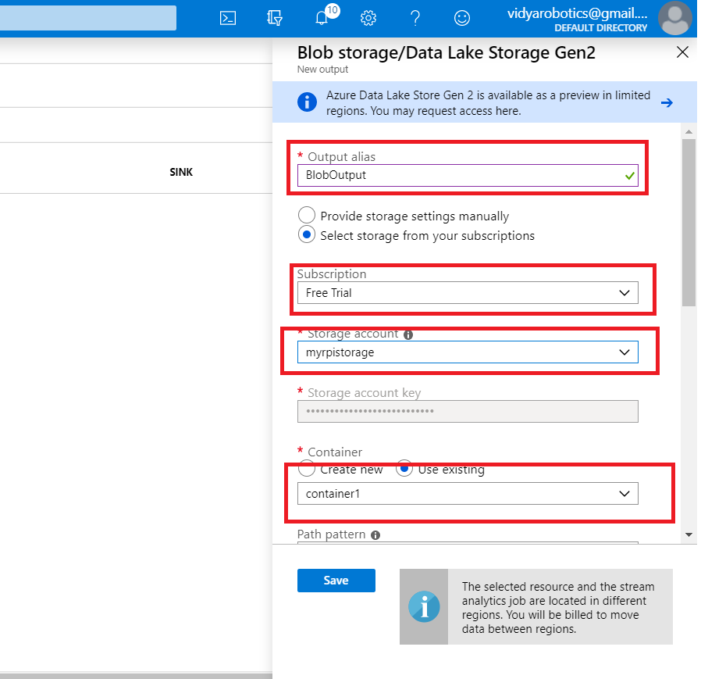

Slide 57
SELECT * INTO BlobOutput FROM IoTHubInput

Slide 58
Send Sample Data
https://azure-samples.github.io/raspberry-pi-web-simulator/

Slide 59
PowerBI with Azure IoT Hub

Slide 60
Process
Add a consumer group to your IoT hub
Create, configure, and run a Stream Analytics job
Add an input to the Stream Analytics job
Add an output to the Stream Analytics job
Configure the query of the Stream Analytics job
Run the Stream Analytics job
Create and publish a Power BI report to visualize the data

Slide 61
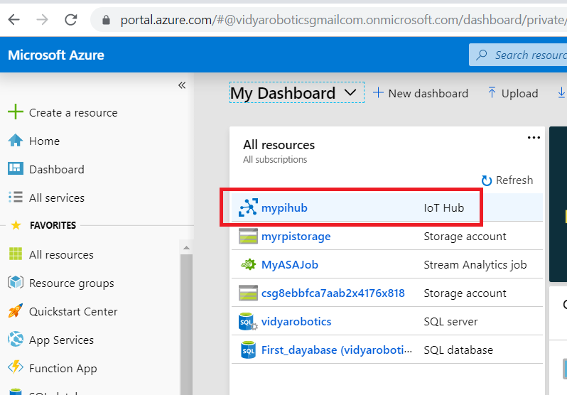

Slide 62
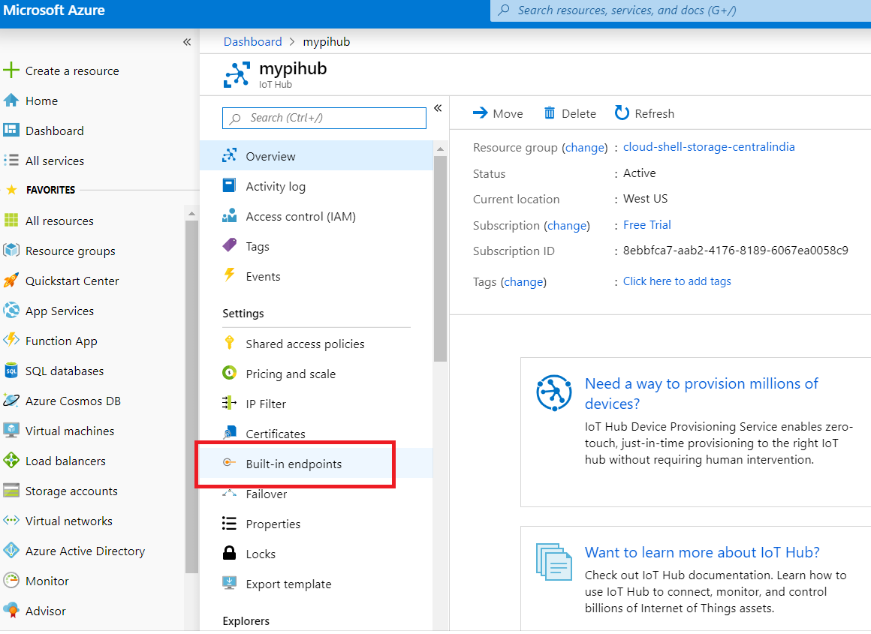

Slide 63
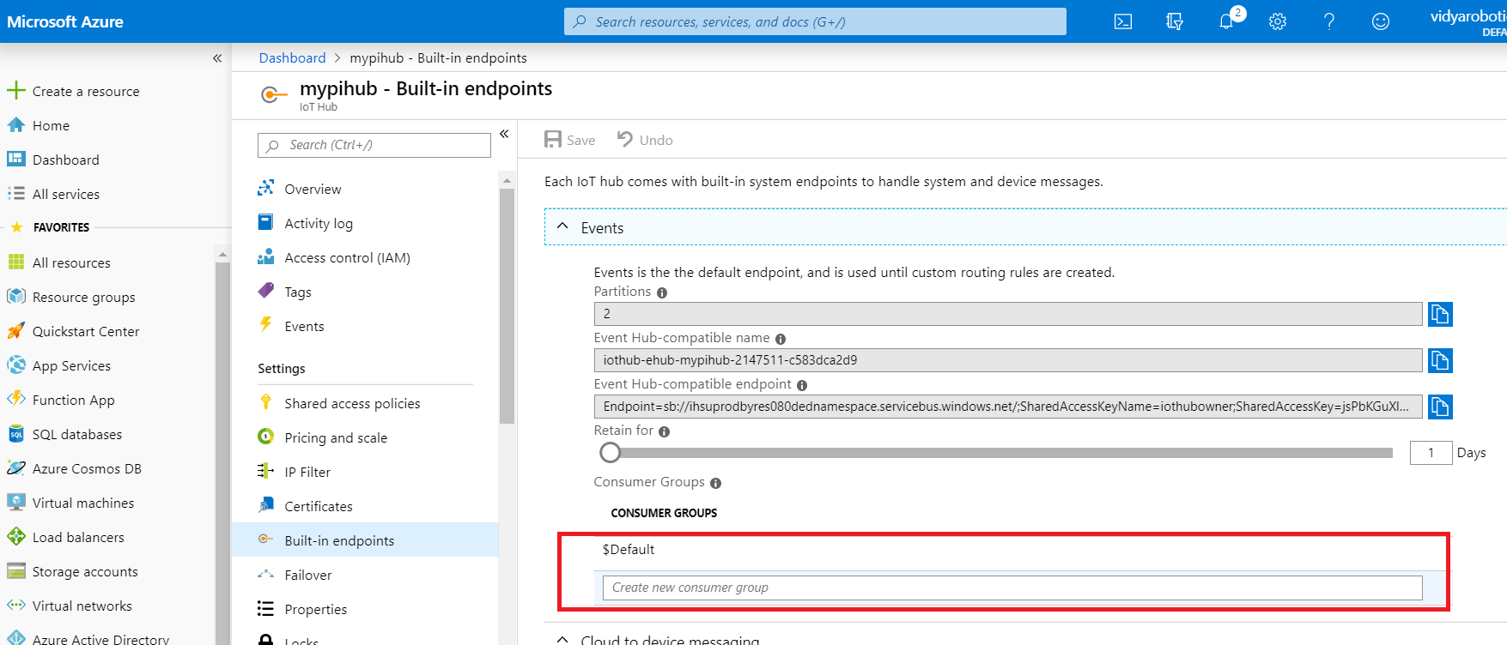

Slide 64
